Slide 1
Rationing and crisis care
Brian Locke, MD
Notes:
Goal:
Clarity to some of the ethical principles that might come in to play
Reassurance that even in the worst case, we (medicine at large) have a plan
Share some details.

Slide 2
Medical Ethics and COVID
@UtahIMCMRs
Notes:
Moral distress: Moral distress is the emotional state that arises from a situation when a provider feels that the ethically correct action to take is different from what he or she is tasked with doing. When policies or procedures prevent a provider from doing what he or she thinks is right, that presents a moral dilemma.
=> Extension: acting in a morally ambiguous situation: anticipatory moral distress?

Slide 3
Medical Ethics First, Do no harm
@UtahIMCMRs
Notes:
Principles of Medical Ethics:
Autonomy - informed and understand to make decisions free from coercion
Justice - benefits distributed equally among groups in society - requires, fair distribution of scarce resources
Beneficence - intent of doing good to the patient
Non-malfeasance - avoid doing harm, either by commission or omission
What do we do when they conflict?
”It is commonly agreed that, ever since the beginnings of ethical reflection, non-maleficence has been the most important of all principles, and should be given priority when in conflict with others (2)”
However, our intuitions break down

Slide 4
Case1a: Ventilator scarcity
65M comes in with COVID19, hypoxic respiratory failure, is intubated, and develops ARDS
Ventilated for 1 week without improvement. P:F is 75 (bad)
We are out of ventilators
Is it justified to terminally extubate, against the patient and family’s wishes, to use that ventilator to save more lives (likely several).
Notes:
Say you have a 45M on the ventilator with severe ARDS. He has very stiff, fibroses lungs he has been on the vent for a week and not made progress- long time required. You can terminally extubate - against the patient and family’s wishes - to use that ventilator to save potentially many more (or 1 more, but with a greater chance of success)
Note: this is not a case of futility. The ventilated patient might live.
Generalized: should we withdraw ventilation from someone to give to another with better chance of surviving?
Beneficence and non-malfeasance are in direct conflict here.
Principle of beneficence suggests we try to do the greatest amount of good for the greatest amount of people…
Principle of nonmalfecence = don’t act to harm (either by omission or commission)
Focusing on ventilators because there have already been ventilator shortages in other parts of the country AND the provision of ventilator support is life-or-death. However, same considerations apply to other scarce resources (e.g. specialist expertise, ICU beds, dialysis machines, supplies of treatments if found effective, a vaccine once available, the next pandemic… etc.)

Slide 5
Case1B: Ventilator scarcity
65M comes in with COVID19 and is extremely hypoxic. Due to comorbidities, their prognosis is poor.
Other patients with better prognosis require intubation.
We are out of ventilators
Is it justified to withhold intubation, against the patient and family’s wishes, to use that ventilator to save more lives (likely several).
Notes:
Likely less internal resistance:
Omission bias is the tendency to favor an act of omission over one of commission
Non-action vs action:
Is it worse to terminally extubate someone against their wishes than to never intubate them, also against their wishes?
Argument against - outcomes are the same. Shouldn’t matter
Argument for difference - legal liability on actually withdrawing care if the patient desires it? (“The criminal law generally penalizes
actions, not refusals to act.”). Would this be murder (or manslaughter, if there was not certainty, but high likelihood)?

Slide 6
Trolley problem omission v commission
@UtahIMCMRs
Notes:
The fact that we even consider this demonstrates omission bias
Consequentialist = actions should be judged based on their results = favors action
Deontologists = actions should be judged based on the virtue of the action = favors inaction
------
Doctrine of Double Effect:
“the nature of the act is itself good, or at least morally neutral;
the agent intends the good effect and does not intend the bad effect either as a means to the good or as an end in itself;
the good effect outweighs the bad effect in circumstances sufficiently grave to justify causing the bad effect and the agent exercises due diligence to minimize the harm
“
Doesn’t entirely apply here.
——

Slide 7
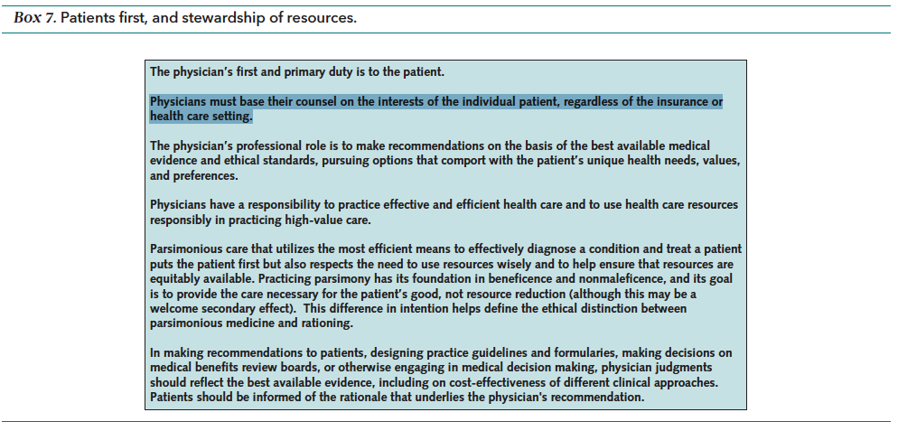
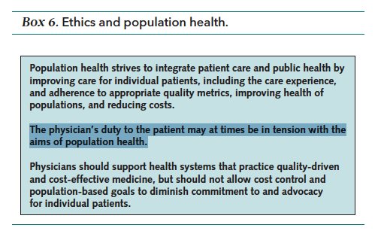
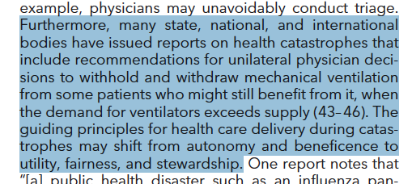
Obligations to Our patient vs society
DOI: 10.7326/M18-2160
@UtahIMCMRs
Notes:
A second objection: Doctors have a duty to their individual patients - when does the public good of society supersede our duty to individual patients?
(I will act such that my patient may do worse so that others might live. Do I have a special obligation to my patient?)
First-serve would be the de-facto
How do we weigh lives against each other?
Scarcity is not new - in fact It’s new to not have it. This is my quick little plug for the GHUT track. At that interestingly, even if in this case we ultimately don’t need to ration - it’s inevitable that pandemics will return
===> If so, first-come, f
NY - greatest chance of surviving the acute episode. Age or presence of certain comorbidites as an exclusion (
“Professional society guidelines2 and some states’ recommendations
exclude from access to ICUs large
groups of patients with certain comorbid conditions,
such as class III or IV heart failure, severe chronic lung
disease, end-stage renal disease, and severe cognitive
impairment.2,3 These exclusions are not explicitly justified,
and they are ethically flawed because the criteria
for exclusion (long-term prognosis and functional status)
are selectively applied to only some types of
patients, rather than to all patients being considered
for critical care.”
equal opportunity to pass through the
stages of life—childhood, young adulthood, middle age,
and old age

Slide 8
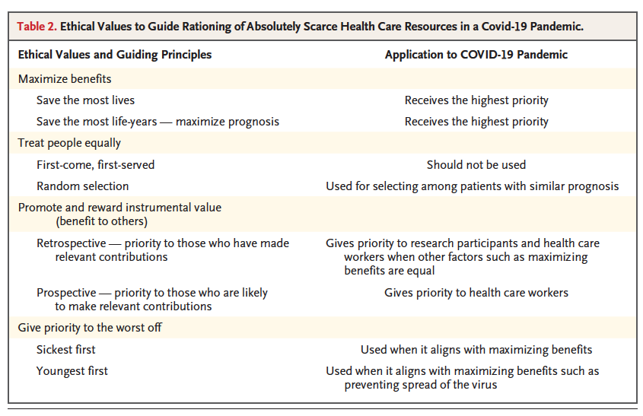
Why individual patient first isn’t ethical
@UtahIMCMRs
Notes:
Justice
Obligation to individual patients = First come first served. Capricious that the fact that I met a patient first should determine resources allocated.
(“ utilitarian ethical perspectives that emphasize population outcomes and with nonutilitarian views that emphasize the paramount value of each human life”)
All these options probably make you uncomfortable (if you’re like me), because a.) who am I to say who lives and dies? And b.) I can’t predict the future, what if we allocate incorrectly?
===> implication: maximizing benefits means that removing a patient from a ventilator would be justified if it was needed for someone with a better chance at survival, or an equal chance of survival but more “life to live”.

Slide 9
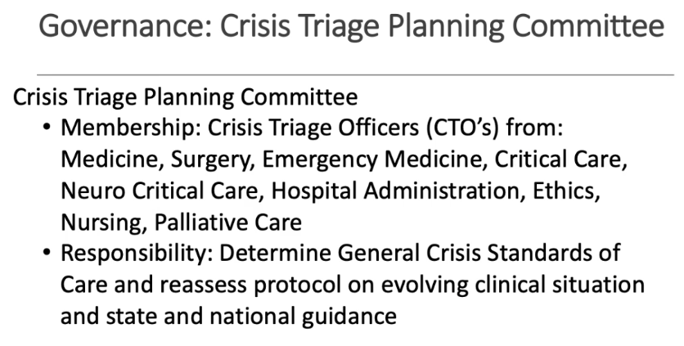
Solution Crisis triage teams
Senior clinicians
Not involved in patient care
No duty to individual patient
Decide who gets resources
DOI: 10.1056/NEJMp2005689
Notes:
Principles to reason w scarcity: maximizing the benefits produced by scarce resources, treating people equally, promoting and rewarding instrumental value, and giving priority to the worst off
-> testing, PPE, ICU beds, ventilators,
therapeutics, and vaccines should go to healthcare workers first because we have incurred risk and provide instrumental value to the outbreak.
Strategies to address these issues:
-Triage committee composed of clinicians who are NOT directly involved with the care of the patient (who are more likely to feel disproportionate responsibility to the individual)
———-
https://pulse.utah.edu/program/COVID19/videos/daily-clinical-updates/april-3
Crisis standard of care - UT specific. Governor declares this

Slide 10
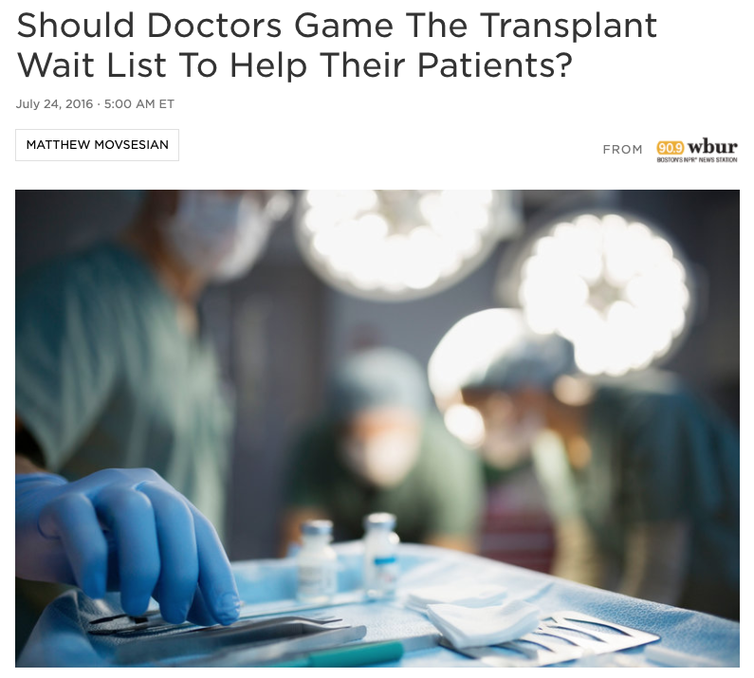
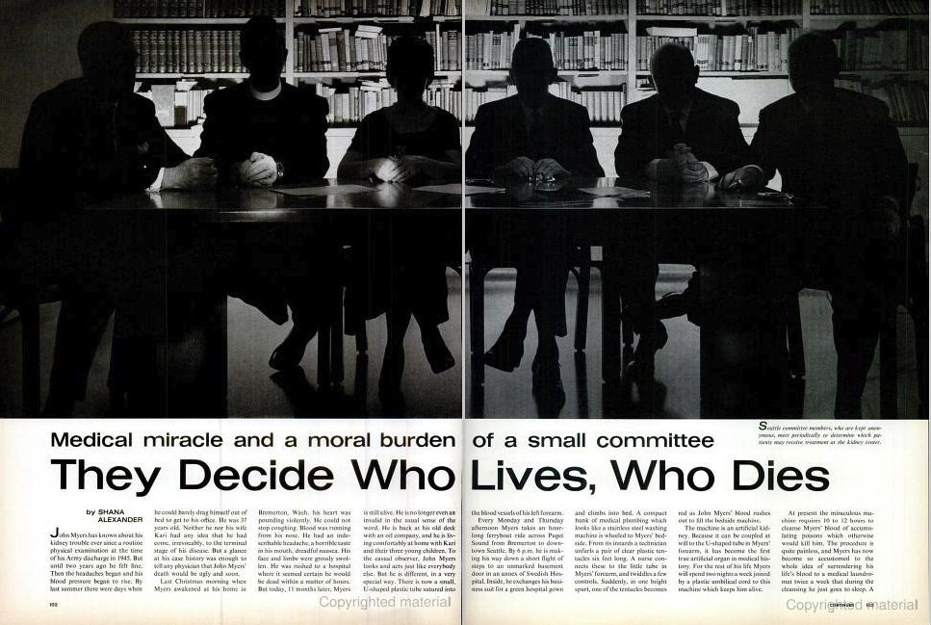
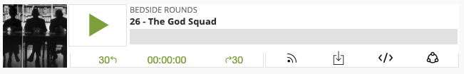
Rationing care: dialysis, transplants
http://www.nephjc.com/news/godpanel
@UtahIMCMRs
Notes:
We have been here once before with dialysis - deciding who lives or dies based on dialysis (and, transplant) criteria.
Precedent for this conflict: Rationing Care
1962 – The God Squad, deciding who lives and dies = who gets the first 10 dialysis units. The other 30 dies.
This is the start of medical ethics and rationing.

Slide 11
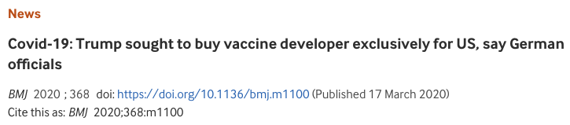
Rationing care: COVID Vaccine
Who gets the vaccine first?
@UtahIMCMRs

Slide 12
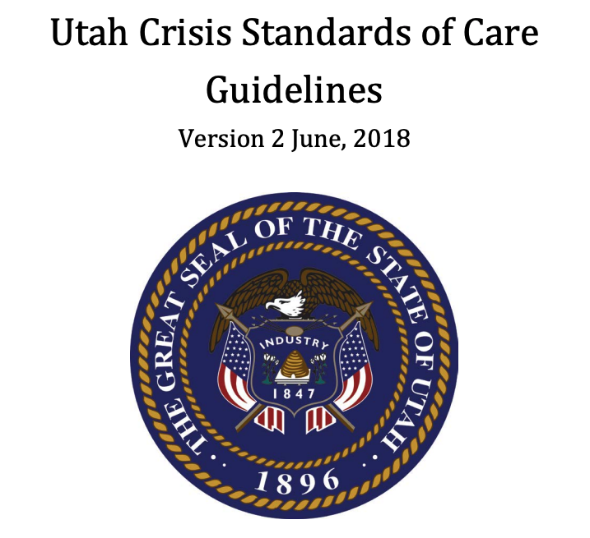
UTah crisis standards of care
Declared by the Governor
Legal protections for providers re: scope of care
https://pulse.utah.edu/program/COVID19/videos/daily-clinical-updates/april-3
Notes:
-Do we, as the recipient’s of societies resources to train doctors, have an obligation to society? --
PPE shortages: do we have an obligation to work?
——
Closing shot: how do you think we should decide who gets vaccinated first when it becomes available?
HCW for instrumental value…
By country? By$? By ability to restart the economy? Older people? Younger people?

Slide 13


